Slide 1
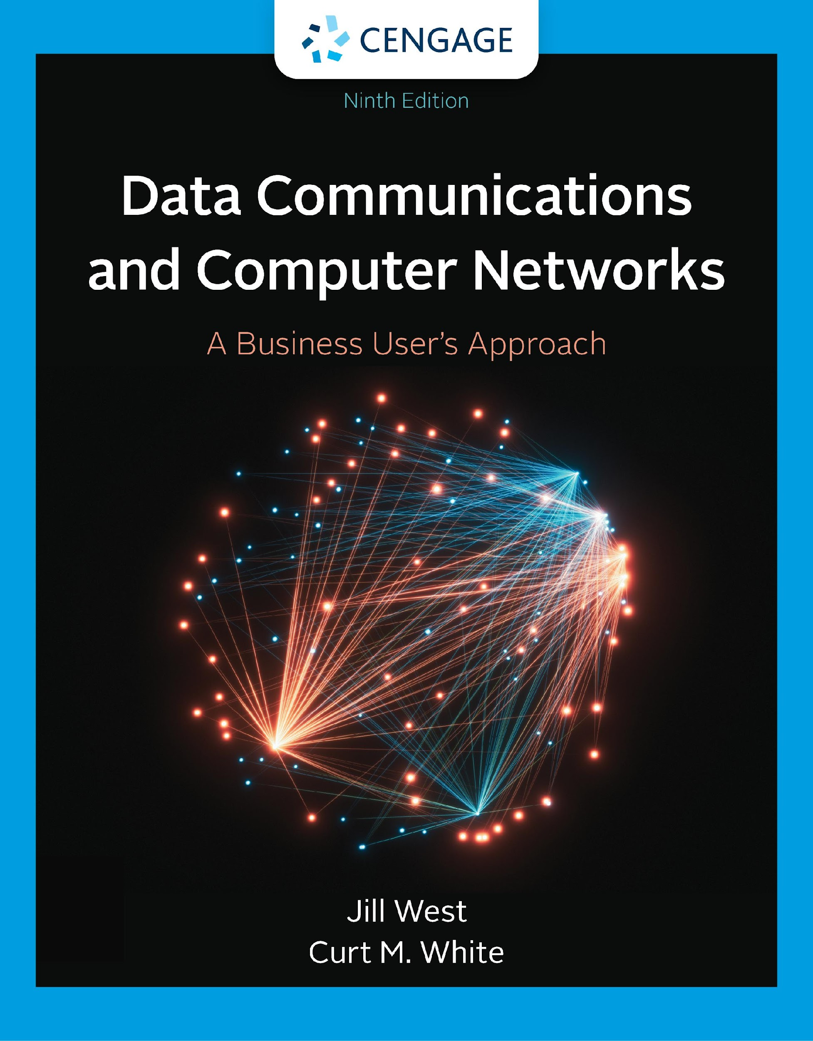
Chapter 1
Introduction to Computer Networks and Data Communications
Jill West | Curt M. White, Data Communications and Computer Networks: A Business User’s Approach, 9th Edition. © 2023 Cengage. All Rights Reserved. May not be scanned, copied or duplicated, or posted to a publicly accessible website, in whole or in part.

Slide 2
After reading this chapter, you should be able to:
Understand and employ the basic terminology of computer networks
Identify the most common computer network devices and their usage
Outline the basic networks types and their characteristics
List the layers of the TCP/IP protocol suite and describe the duties of each layer
List the layers of the OSI model and describe the duties of each layer
Understand the cloud computing concepts and its importance

Slide 3
Introduction
Who today has not used a computer network?
Mass transit, interstate highways, 24-hour bankers, grocery stores, cable television, smartphones, businesses and schools, and retail outlets support some form of computer network

Slide 4
The Language of Computer Networks (1 of 3)
Computer network – an interconnection of computers and computing equipment using either wires or radio waves over small or large geographic areas
Wireless computer networks – networks that rely on different kinds of low energy radiation
PAN: Personal Area Network – a network of a few meters, between wireless devices such as PDAs, laptops, and similar devices
LAN: Local Area Network – networks that are small in geographic size spanning a room, floor, building, or campus

Slide 5
The Language of Computer Networks (2 of 3)
CAN: Campus Area Network – a network that spans multiple buildings on a business or school campus
MAN: Metropolitan Area Network – networks that serve an area of 1 to 30 miles, approximately the size of a typical city
WAN: Wide Area Network – a large network that encompasses parts of states, multiple states, countries, and the world

Slide 6
The Language of Computer Networks (3 of 3)
Data communications and protocols – the transfer of digital or analog data using digital or analog signals following predefined standards
Network management – the design, installation, and support of a network, including its hardware and software
Cloud computing – service provided over the Internet instead of provided by an underlying hardware

Slide 7
The Big Picture of Networks (1 of 2)
Networks are composed of many devices, including:
Workstations (computers, tablets, smartphones, etc.)
Servers
PANs
Network switches
Routers (LAN to WAN and WAN to WAN)
Network nodes and subnetworks

Slide 8
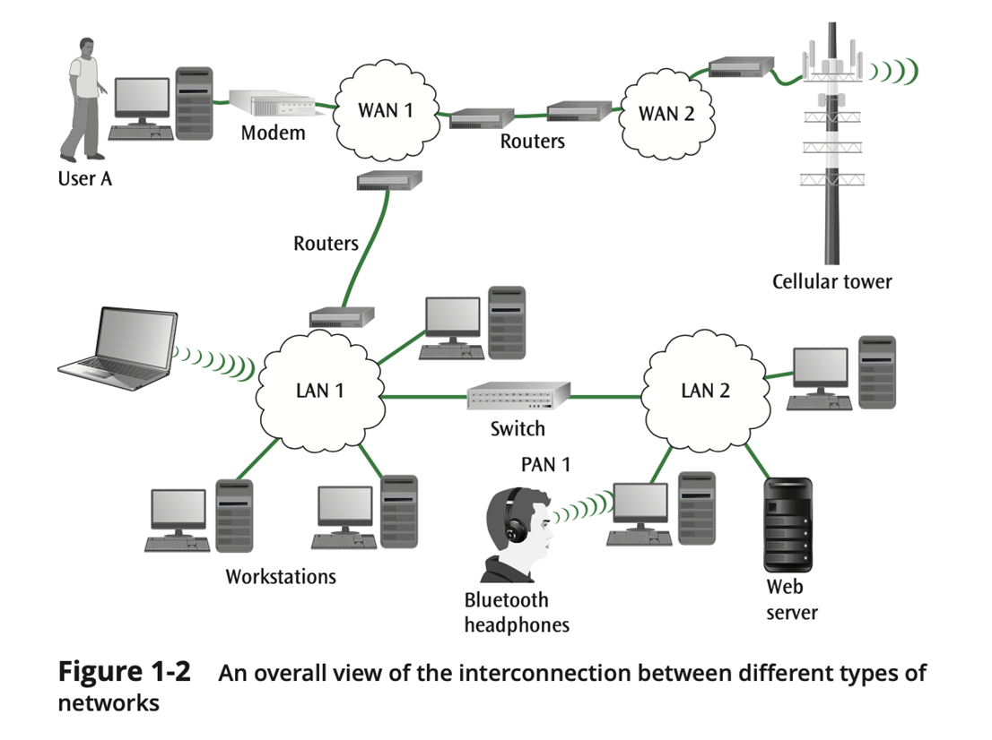
The Big Picture of Networks (2 of 2)

Slide 9
Common Examples of Communications Networks (1 of 2)
The desktop computer and the Internet
A laptop computer and a wireless connection
Cellular networks
Sensor networks
Business mainframe networks
Satellite networks
Cloud networks

Slide 10
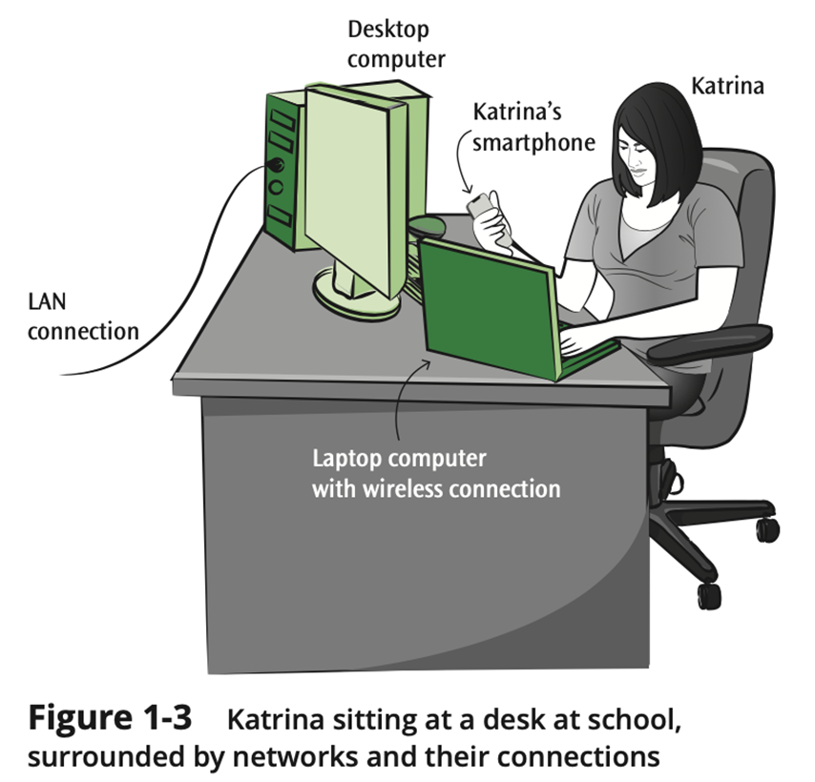
Common Examples of Communications Networks (2 of 2)

Slide 11
The Desktop Computer and the Internet (1 of 4)
Common throughout business, academic environments, and homes
Typically, a medium- to high-speed connection
Computer (device) requires a NIC (network interface card)
NIC connects to a hub-like device (switch)
Often considered a client/server system

Slide 12
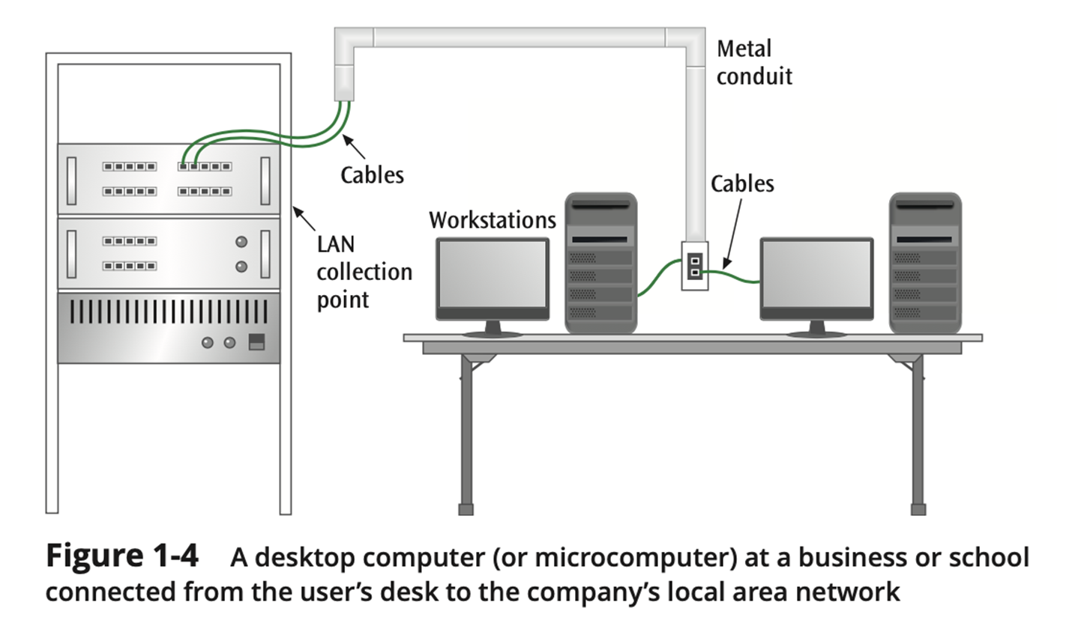
The Desktop Computer and the Internet (2 of 4)

Slide 13
The Desktop Computer and the Internet (3 of 4)
At work or at school – connection is typically some form of Ethernet
At home, for some, a dial-up modem is used to connect user’s microcomputer to an Internet service provider
Technologies such as DSL and cable modems are replacing dial-up modems

Slide 14
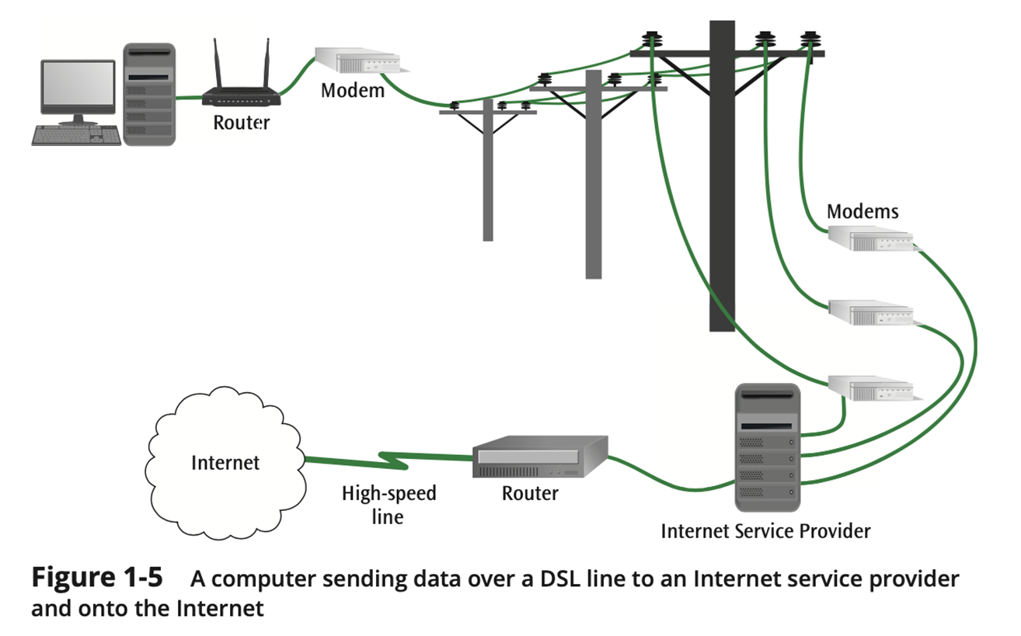
The Desktop Computer and the Internet (4 of 4)

Slide 15
A Laptop Computer and a Wireless Connection (1 of 2)
At work or at school – connection is typically some form of wireless Ethernet
Laptop wirelessly communicates with a wireless router or wireless access point
Wireless router is typically connected to a wired-network

Slide 16
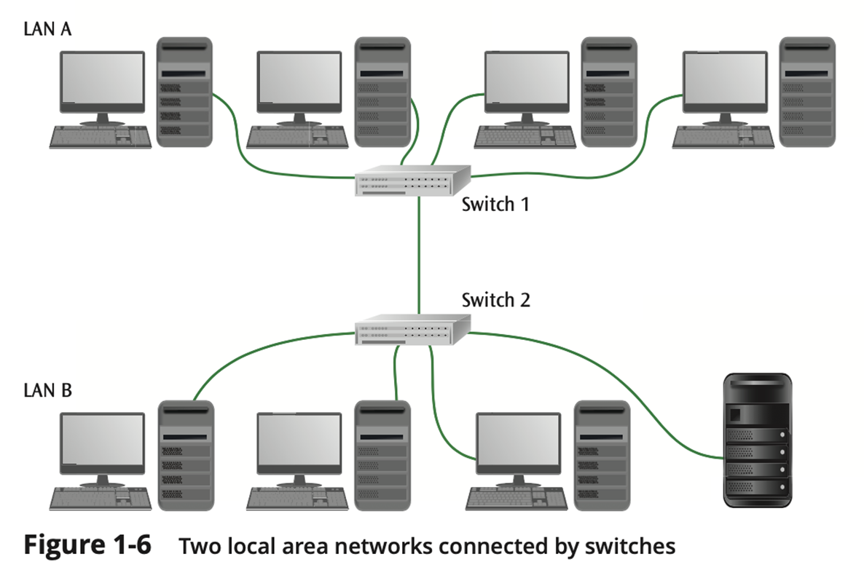
A Laptop Computer and a Wireless Connection (2 of 2)

Slide 17
Cellular Networks (1 of 2)
Constantly expanding market across the U.S. and world
5G services available in many areas and under many types of plans with an ever-evolving set of services continuing to appear
Latest generation includes higher speed data transfers (20 Gigabits per second for 5G)

Slide 18
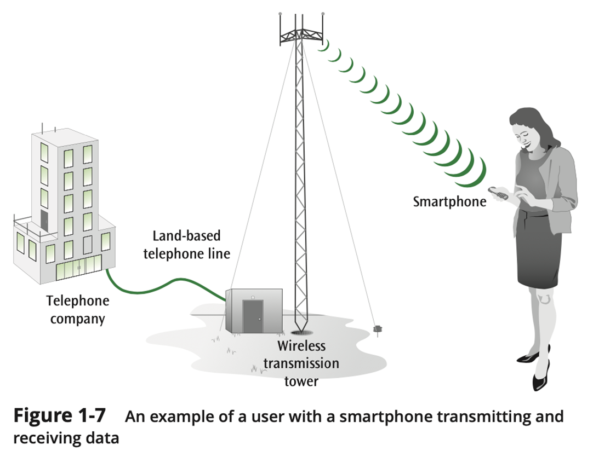
Cell Phone Networks (2 of 2)

Slide 19
Industrial Sensor-based Systems (1 of 2)
Not all local area networks deal with microcomputer workstations
Often found in industrial and laboratory environments
Assembly lines and robotic controls depend heavily on sensor-based local area networks

Slide 20
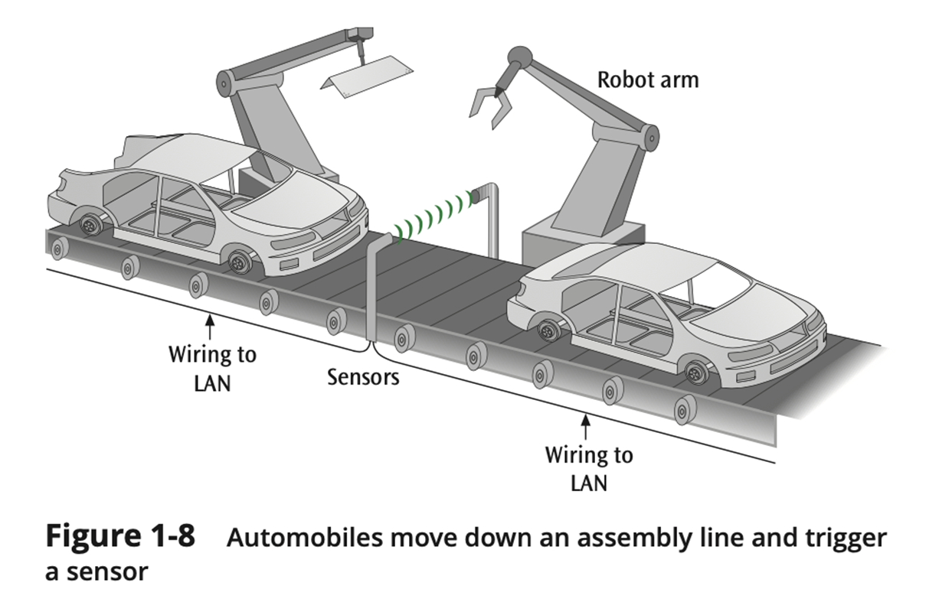
Industrial Sensor-based Systems (2 of 2)

Slide 21
Mainframe Systems (1 of 2)
Predominant form in the 1960s and 1970s
Still used in many types of businesses for data entry and data retrieval
Few dumb terminals left today – most are microcomputers with terminal emulation card, a web browser and web interface, Telnet software, or a thin client

Slide 22
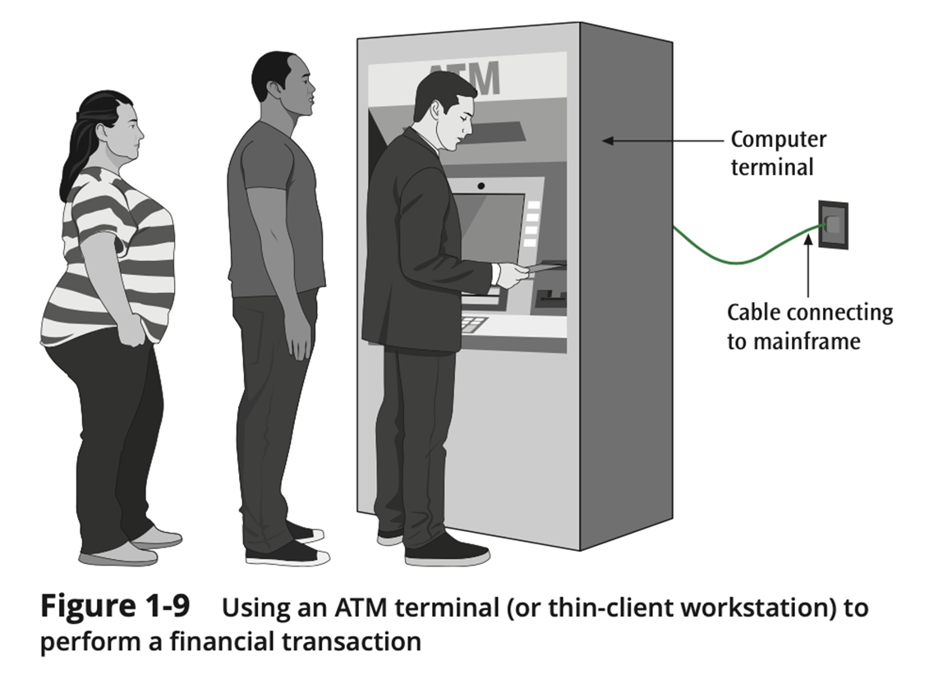
Mainframe Systems (2 of 2)

Slide 23
Satellite and Microwave Networks (1 of 2)
Typically long distance wireless connections
Many types of applications including long distance telephone, television, radio, long-haul data transfers, and wireless data services
Typically expensive services but many companies offer competitive services and rates
Newer shorter-distance services such as Wi-Max

Slide 24
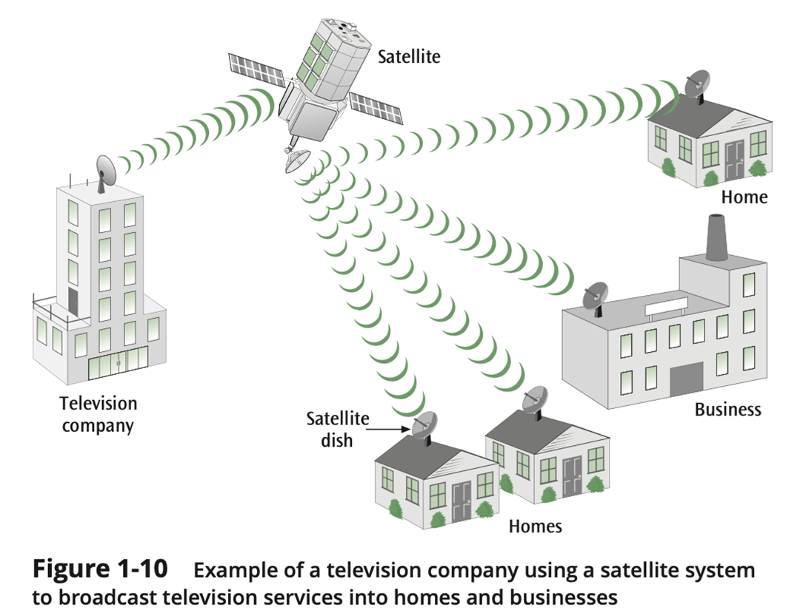
Satellite and Microwave Networks (2 of 2)

Slide 25
Cloud Networks (1 of 2)
Networks that connect resources that reside “in the cloud”
Based on the concept of virtualization of services (virtualization software - hypervisor)
Typically creating virtual machines
Public clouds
Private clouds
Hybrid clouds

Slide 26
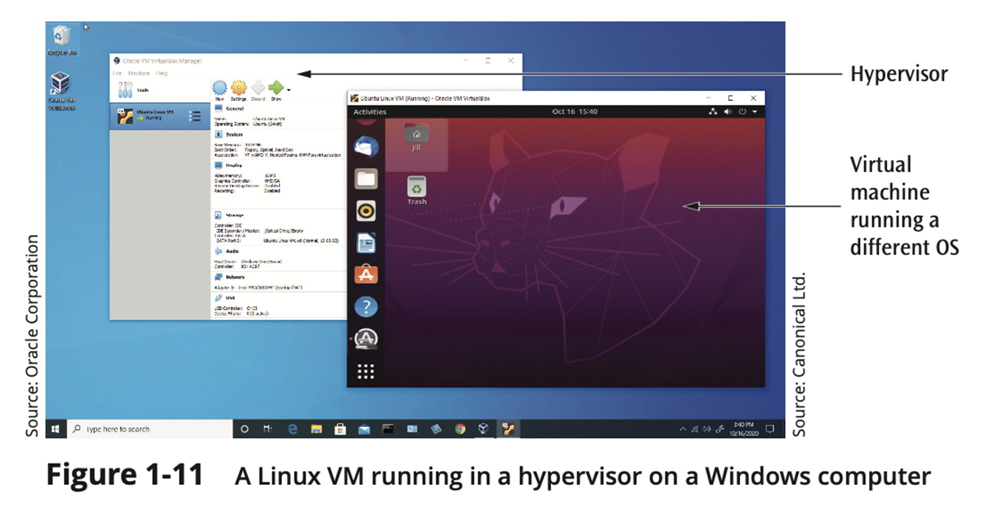
Cloud Networks (2 of 2)

Slide 27
Network Architectures
A reference model that describes the layers of hardware and software necessary to transmit data between two points or for multiple devices/applications to interoperate
Reference models are necessary to increase likelihood that different components from different manufacturers will converse
Two models to learn: TCP/IP protocol suite and OSI model

Slide 28
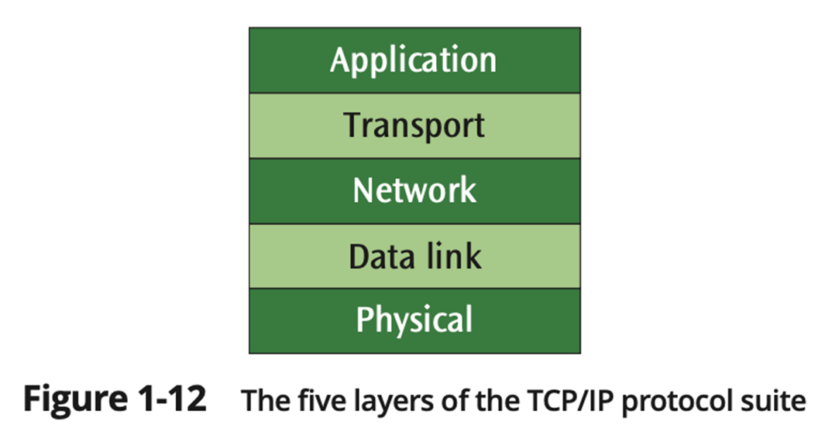
The TCP/IP Protocol Suite (1 of 4)
Note: Some authors show only four layers, combining the two bottom layers.

Slide 29
The TCP/IP Protocol Suite (2 of 4)
Application layer
Where the application using the network resides
Common network applications include web browsing, email, file transfers, and remote logins
Transport layer
Performs a series of miscellaneous functions (at the end-points of the connection) necessary for presenting the data package properly to the sender or receiver

Slide 30
The TCP/IP Protocol Suite (3 of 4)
Network (Internet or internetwork or IP) layer
Responsible for creating, maintaining, and ending network connections
Transfers data packet from node to node (e.g., router to router) within network
Network access (data link) layer
Responsible for taking the data and transforming it into a frame with header, control and address information, and error detection code, then transmitting it between the workstation and the network
Physical layer
Handles the transmission of bits over a communications channel
Includes voltage levels, connectors, media choice, modulation techniques

Slide 31
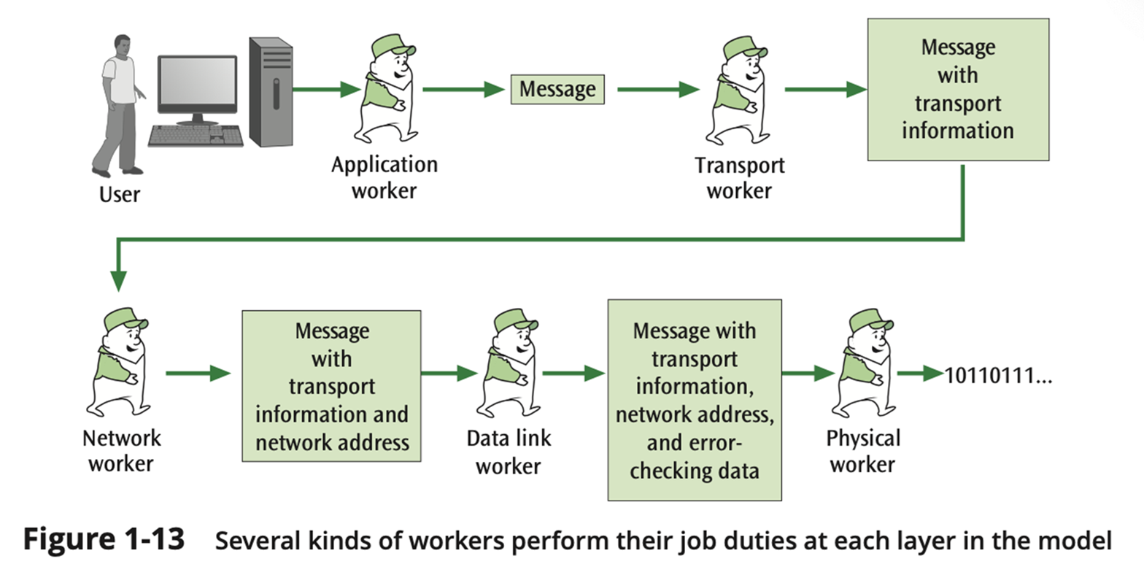
The TCP/IP Protocol Suite (4 of 4)

Slide 32
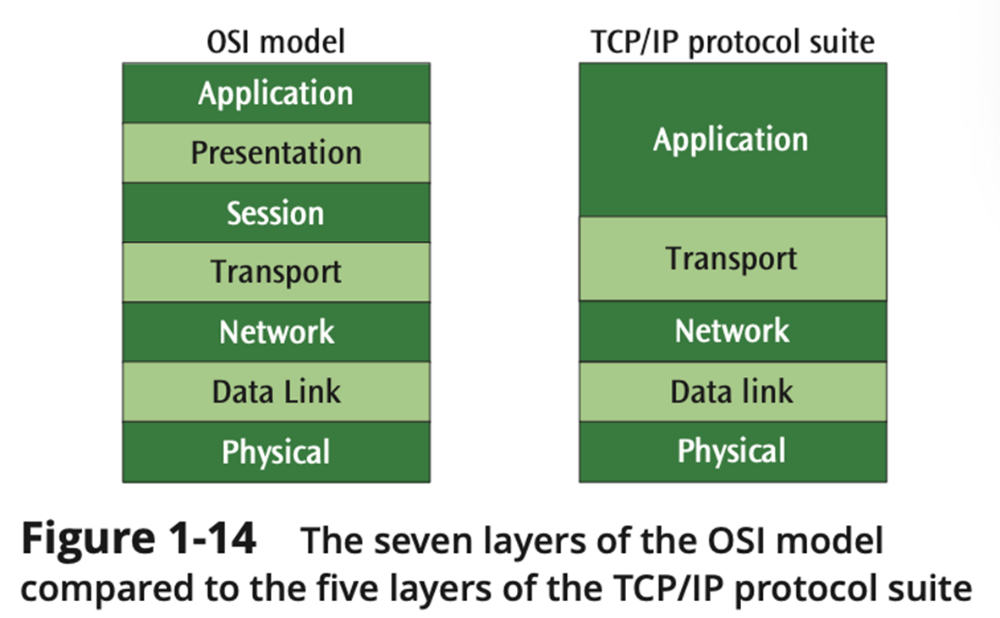
The Open Systems Interconnection (OSI) Model (1 of 4)

Slide 33
The Open Systems Interconnection (OSI) Model (2 of 4)
Application layer
Equivalent to TCP/IP’s application layer
Presentation layer
Responsible for “final presentation” of data (code conversions, compression, encryption)
Session layer
Responsible for establishing “sessions” between users

Slide 34
The Open Systems Interconnection (OSI) Model (3 of 4)
Transport layer
Equivalent to TCP/IP’s transport layer
Network layer
Equivalent to TCP/IP’s network layer
Data link layer
Responsible for taking the data and transforming it into a frame with header, control and address information, and error detection code

Slide 35
The Open Systems Interconnection (OSI) Model (4 of 4)
Physical layer
Handles the transmission of bits over a communications channel
Includes voltage levels, connectors, media choice, modulation techniques

Slide 36
Logical and Physical Connections (1 of 3)
A logical connection is one that exists only in the software, while a physical connection is one that exists in the hardware
Note that in a network architecture, only the lowest layer contains the physical connection, while all higher layers contain logical connections

Slide 37
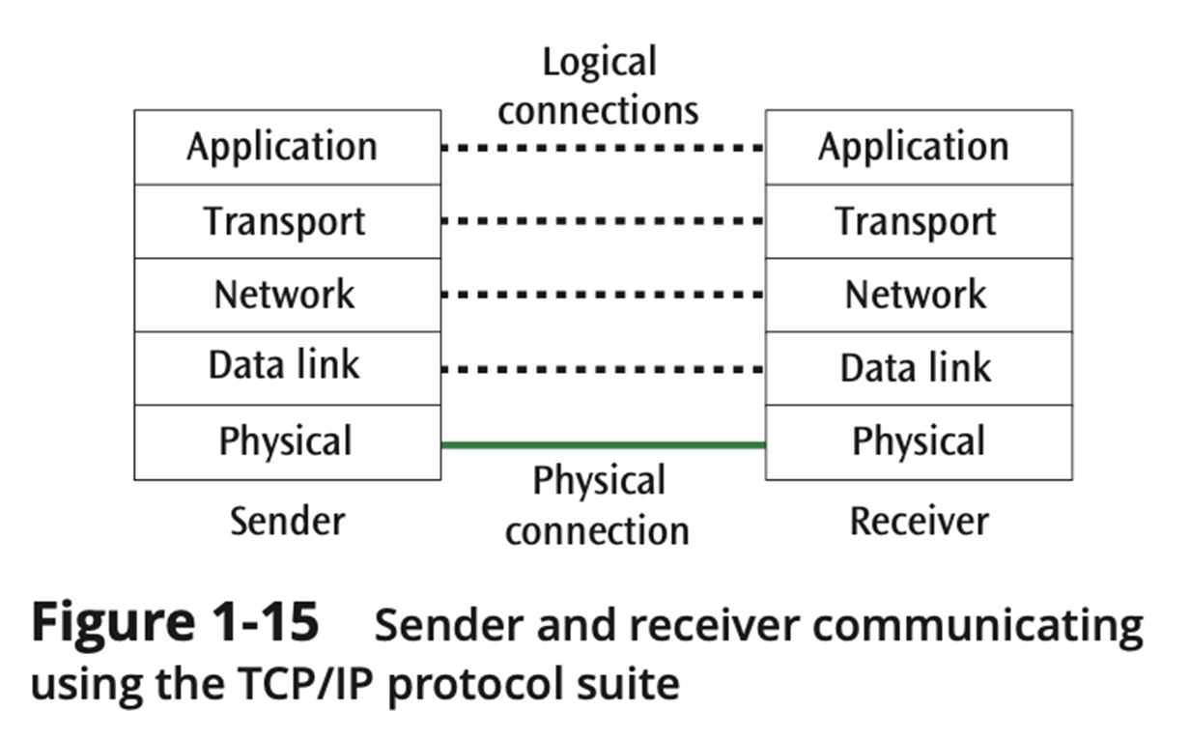
Logical and Physical Connections (2 of 3)

Slide 38
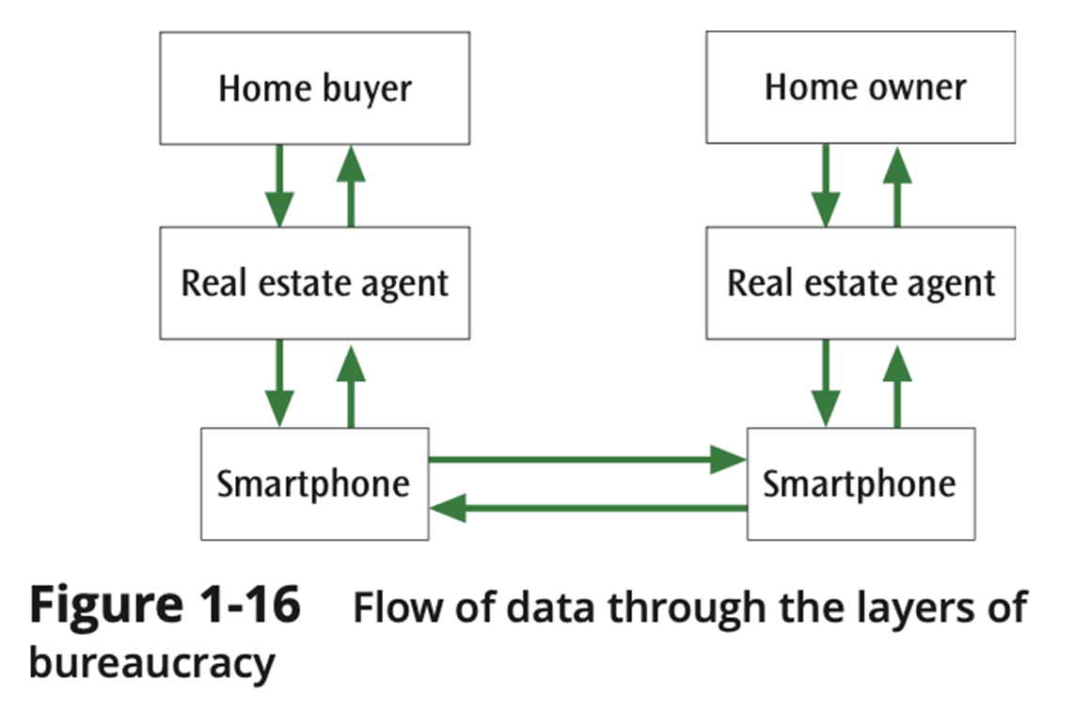
Logical and Physical Connections (3 of 3)

Slide 39
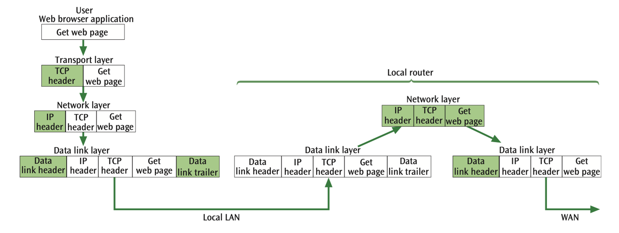
The TCP/IP Protocol Suite in Action (1 of 2)

Slide 40
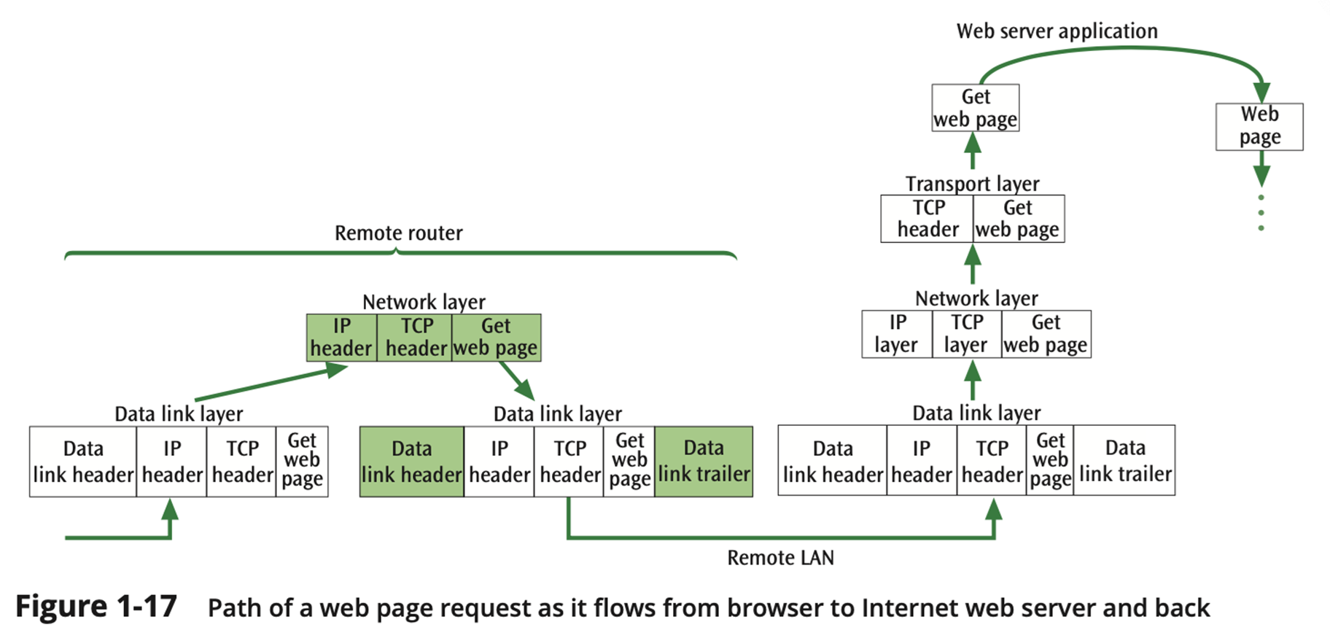
The TCP/IP Protocol Suite in Action (2 of 2)

Slide 41
Cloud Computing (1 of 6)
Cloud computing relies on the abstraction of compute, network, security, and storage functions, instead of underlying over physical hardware
It gives network admins and other IT professionals almost unlimited resources at affordable prices

Slide 42
Cloud Computing (2 of 6)
Characteristics:
Scalability: demands can be adjusted over time
Elasticity: quick increase and decrease in resources
Pay-as-you-go: charged based on the allocated/requested resources
Self-service: change of resources can be controlled by the user automatically
Broad network access: resources can be accessed from any device connected to the Internet
Availability: resources can withstand losses or outages minimizing disruption of service

Slide 43
Cloud Computing (3 of 6)
Models of Service:
SaaS (Software-as-a-Service) to provide applications over cloud resources
PaaS (Platform-as-a-Service) to provide basic configuration options
IaaS (Infrastructure-as-a-Service) to provide deep configuration options to replicate as close as possible the availability of a real data center

Slide 44
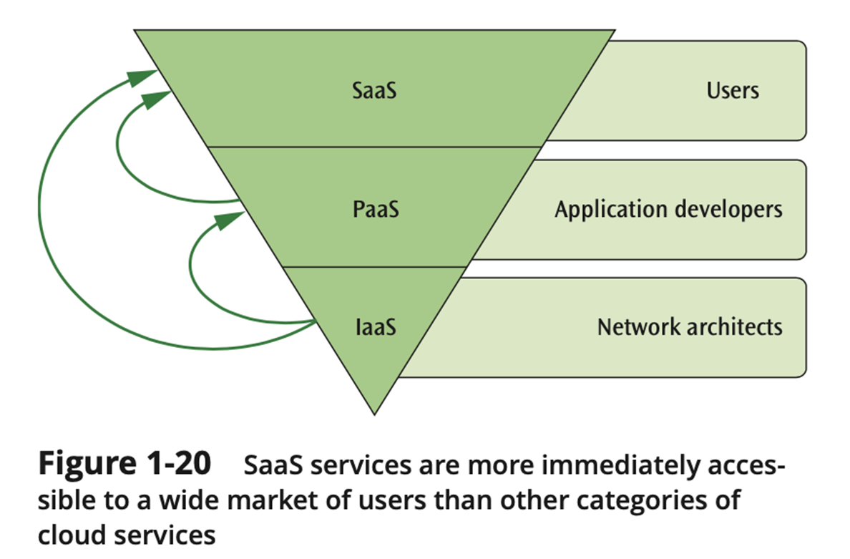
Cloud Computing (4 of 6)

Slide 45
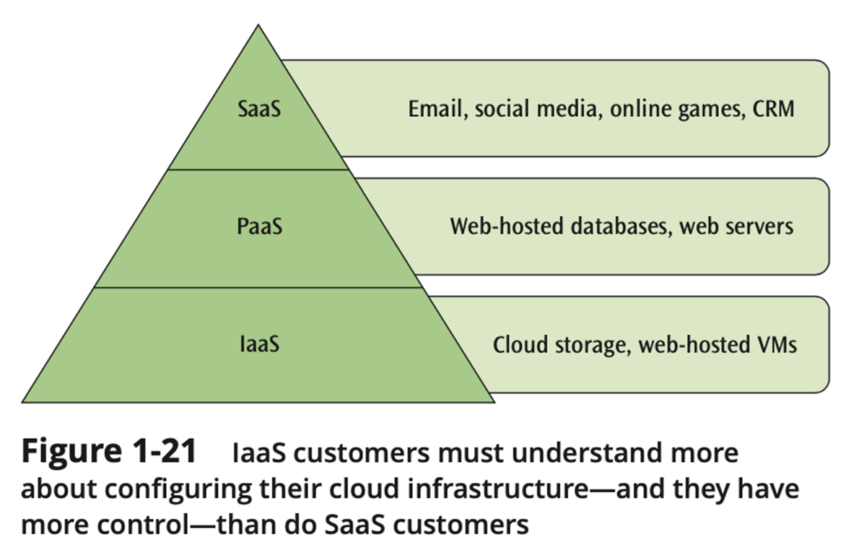
Cloud Computing (5 of 6)

Slide 46
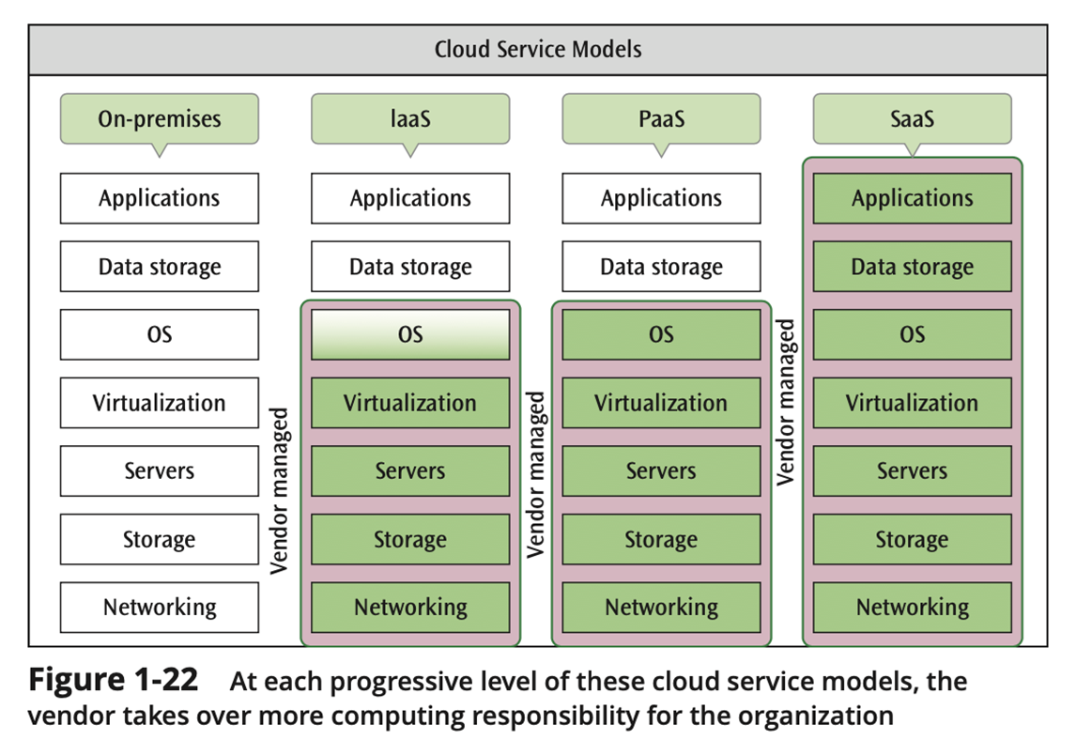
Cloud Computing (6 of 6)

Slide 47
Summary (1 of 5)
Many services and products that we use every day employ computer networks and data communications in some way
Field of data communications and computer networks includes data networks, voice networks, wireless networks, local area networks, metropolitan area networks, wide area networks, and personal area networks

Slide 48
Summary (2 of 5)
Common examples of communications networks:
The desktop computer and the Internet
A laptop computer and a wireless connection
Cellular networks
Sensor networks
Business mainframe networks
Satellite networks
Cloud networks

Slide 49
Summary (3 of 5)
Key concept in networking is convergence
A network architecture, or communications model, places network pieces in layers
Layers define model for functions or services that need to be performed
The TCP/IP protocol suite is also known as the Internet model and is composed of five layers (some show four):
Application layer
Transport layer
Network layer
Network access layer
Physical layer

Slide 50
Summary (4 of 5)
The International Organization for Standardization (ISO) created the Open Systems Interconnection (OSI) model
OSI model is based on seven layers: application layer, presentation layer, session layer, transport layer, network layer, data link layer, physical layer
A logical connection is a flow of ideas that occurs, without a direct physical connection, between the sender and receiver at a particular layer

Slide 51
Summary (5 of 5)
Characteristics of cloud computing are:
scalability
elasticity
pay-as-you-go
self-service
broad network access
availability
Usual cloud services are: SaaS (Software-as-a-Service), PaaS (Platform-as-a-Service), and IaaS (Infrastructure-as-a-Service)

